Slide 1
Presentation Submitted By
DIPU HASAN
ID=18-36364-1
Under the faculty of
TAWSIF IBNE ALAM
ASSISTANT PROFESSOR

Slide 2

TO MY PRESENTATION

Slide 3
TOPIC OF THIS PRESENTATION
DESIGN A SYNCHRONOUS BINARY IRREGULAR COUNTER

Slide 4

WHAT IS SYNCHRONOUS COUNTER

Slide 5
Design a synchronous binary irregular counter with the following count sequence based upon MY unique 5-digit middle portion of MY ID=A→B→C→D→E→A Where ID 18-36364-1
A=3 A=3
B=6 B=6
C=3+2=5 C=5
D=6+1=7 D=7 NOW ALL ARE
E=4 E=4 UNIQUE

Slide 6
NOW ALL ARE UNIQUE NUMBER CONVERT BINARY NUMBER
NUMBER DECIMAL BINARY
A 3 011
B 6 110
C 5 101
D 7 111
E 4 100

Slide 7
Present table |  |  | Next step |  |  |  |  |  |  |  |  | Output transform |  | Flip flop inputs
Q2 | Q1 | Q 0 | q2 | q1 | q0 | j2 | k2 | j1 | k1 | j0 | k0 | Qn | Qn+1 | J | K
0 | 1 | 1 | 1 | 1 | 0 | 1 | X | X | 0 | X | 1 | 0 | 0 | 0 | X
1 | 1 | 0 | 1 | 0 | 1 | X | 0 | X | 1 | 1 | X | 0 | 1 | 1 | X
1 | 0 | 1 | 1 | 1 | 1 | X | 0 | 1 | X | X | 0 | 1 | 0 | X | 1
1 | 1 | 1 | 1 | 0 | 0 | X | 0 | X | 1 | X | 1 | 1 | 1 | X | 0
1 | 0 | 0 | 0 | 1 | 1 | X | 1 | 1 | X | 1 | X

Slide 8
K MAP using truth table
J0
J1
q0 q2q1 | 0 | 1
00 | X | X
01 | X | X
11 | 1 | X
10 | 1 | X
q0 q2q1 | 0 | 1
00 | X | X
01 | X | X
11 | X | X
10 | 1 | 1

Slide 9
J2
K0
q0 q2q1 | 0 | 1
00 | X | X
01 | X | 1
11 | X | X
10 | X | X
q0 q2q1 | 0 | 1
00 | X | X
01 | X | 1
11 | X | 1
10 | X | 0
K1
K2
q0 q2q1 | 0 | 1
00 | X | X
01 | X | 0
11 | 1 | 1
10 | X | X
q0 q2q1 | 0 | 1
00 | X | X
01 | X | X
11 | 0 | 0
10 | 1 | 0

Slide 10
FINAL OUTPUT CONNECTION
J0=Q1.Q0/Q0/Q0.Q0.Q2
J1=Q2/Q1.Q0/Q0
J2=Q1.Q0
K0=Q1.Q0.Q0
K1=Q2
K2=NO CONNECTION

Slide 11
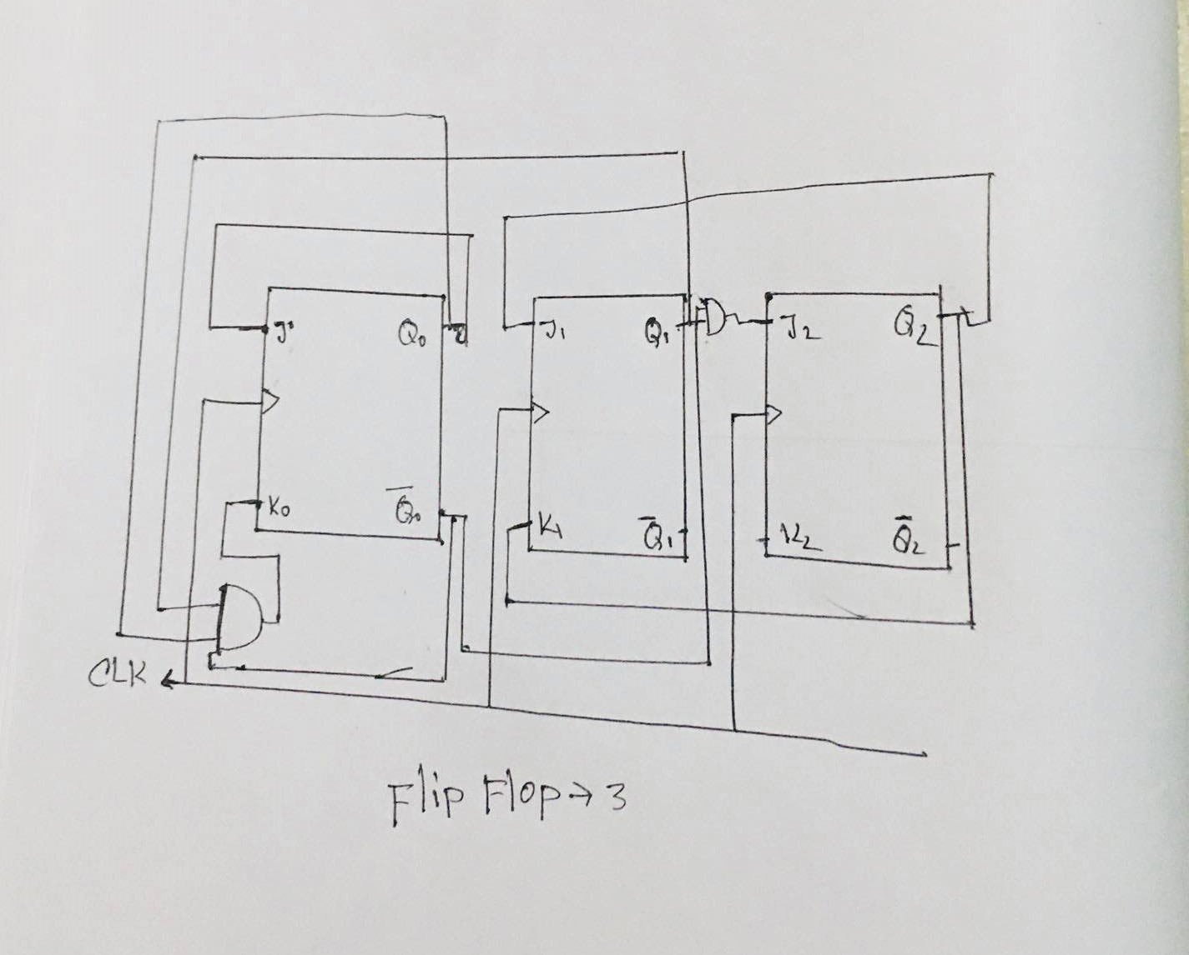
CIRCUIT USING SOP EXPRESSION

Slide 12


